Slide 1
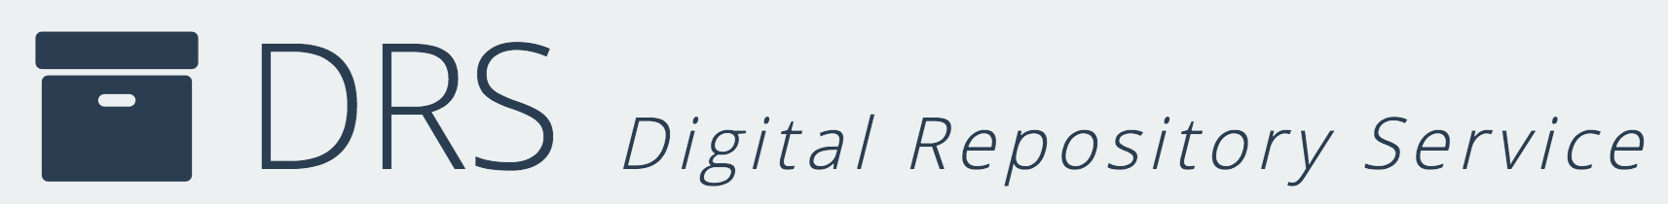
Digital Repositories
Gateways to Digital Stewardship
Sarah Sweeney
Digital Repository Manager
Northeastern University Libraries
repository.library.northeastern.edu
Notes:
Promotional Slide

Slide 2
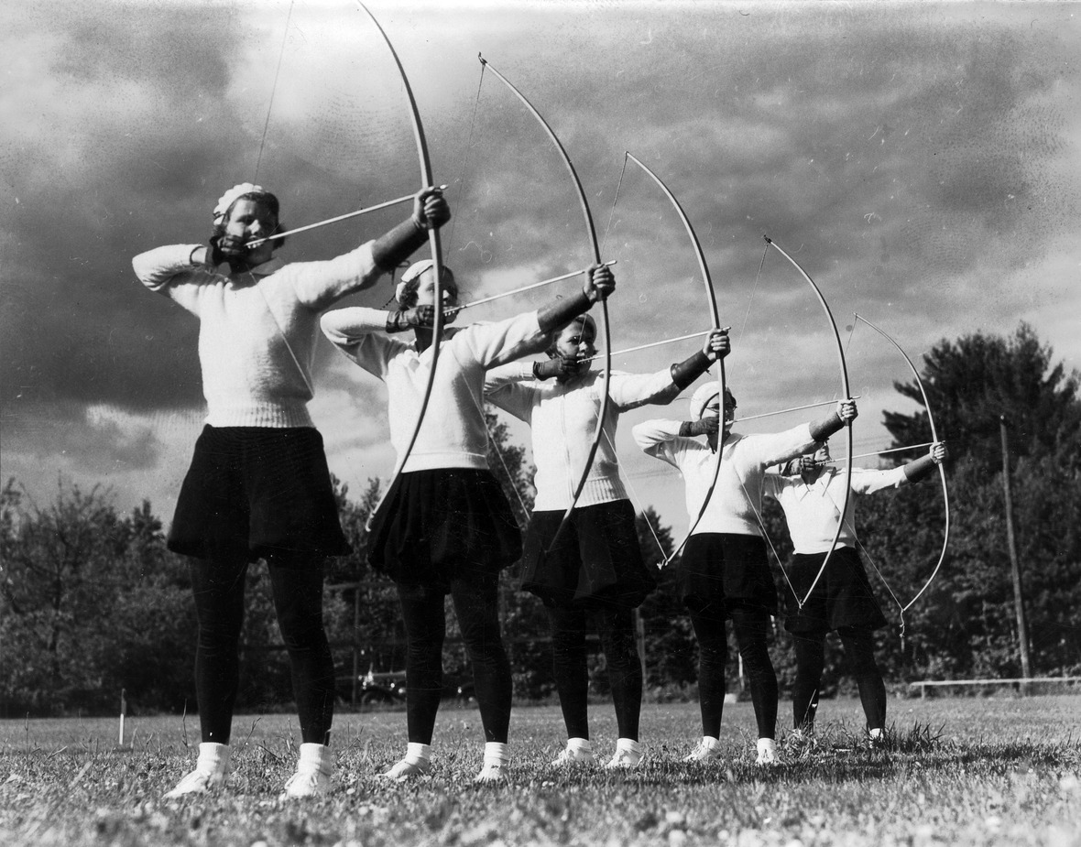
What is Digital Stewardship?
"Digital stewardship encompasses all activities related to the care and management of digital objects over time. Proper digital stewardship addresses all phases of the digital object lifecycle: from digital asset conception, creation, appraisal, description, and preservation, to accessibility, reuse, and beyond."
Archers from Boston-Bouve College. 1934. Northeastern University Library (Boston, Massachusetts), June 9, 2016. http://hdl.handle.net/2047/d20167889

Slide 3
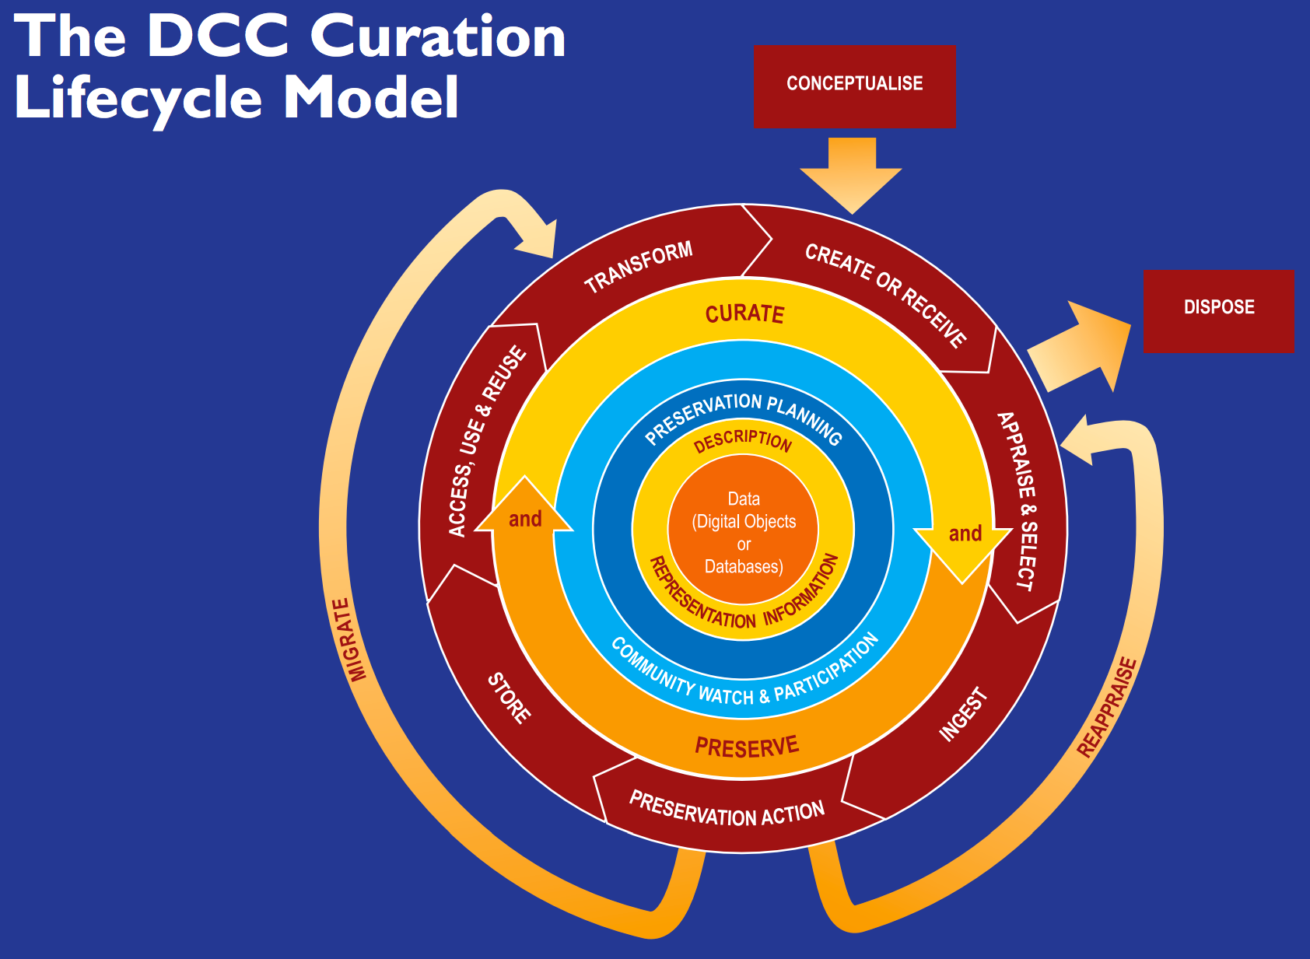
Digital Stewardship in Action
Plan
Collect
Describe
Maintain
DCC Curation Lifecycle Model. Digital Curation Centre. June 9, 2016. http://www.dcc.ac.uk/resources/curation-lifecycle-model

Slide 4
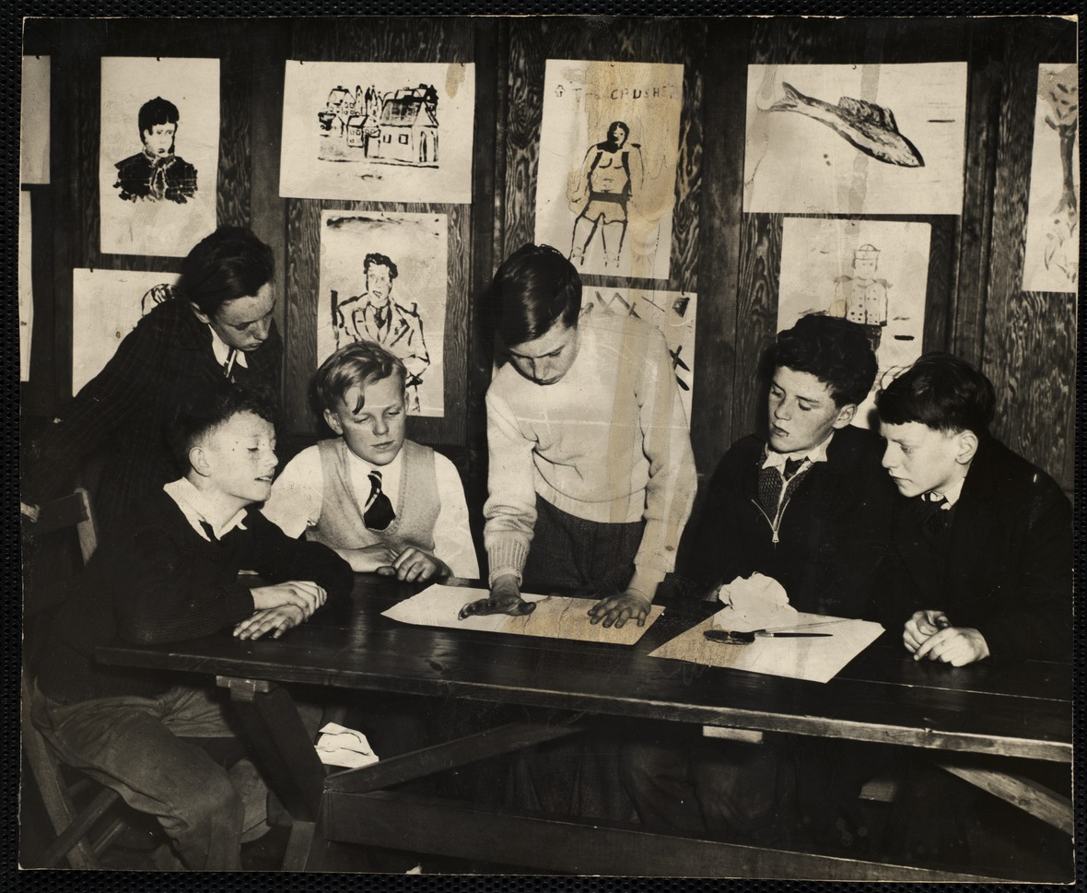
Stewarding
A boy working on a project for his art class while five others look on at the South Boston Boys' Club. ca. 1945. Northeastern University Library (Boston, Massachusetts), June 9, 2016. http://hdl.handle.net/2047/d20164399

Slide 5
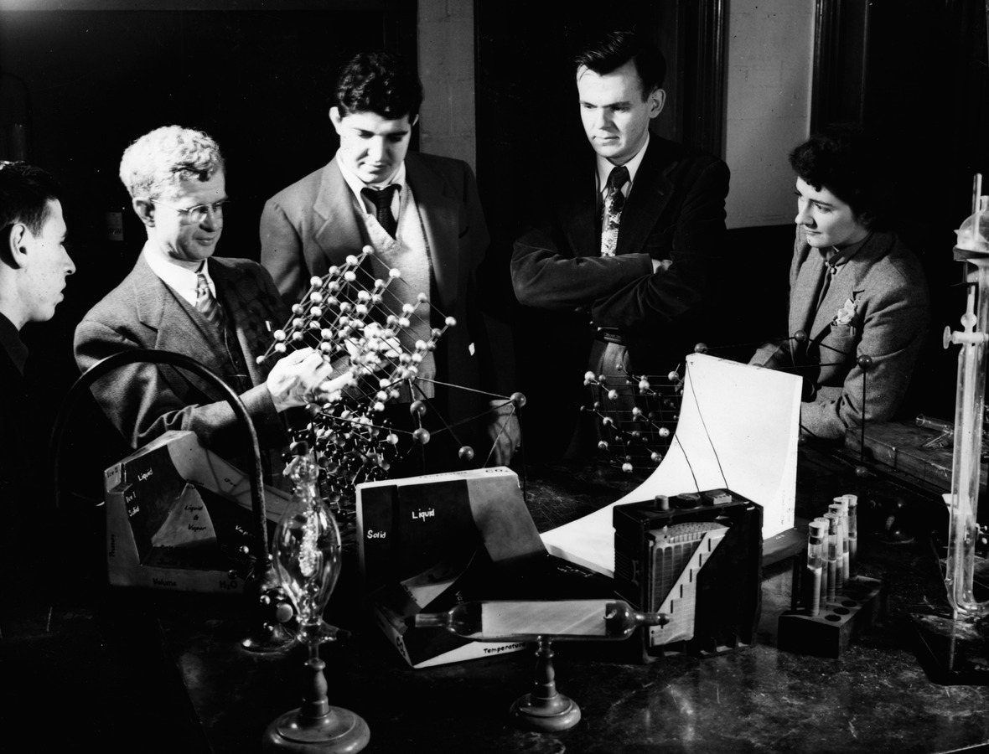
Facilitating Stewardship
Chemistry professor and students. ca. 1925. Northeastern University Library (Boston, Massachusetts), June 9, 2016. http://hdl.handle.net/2047/d20161246

Slide 6
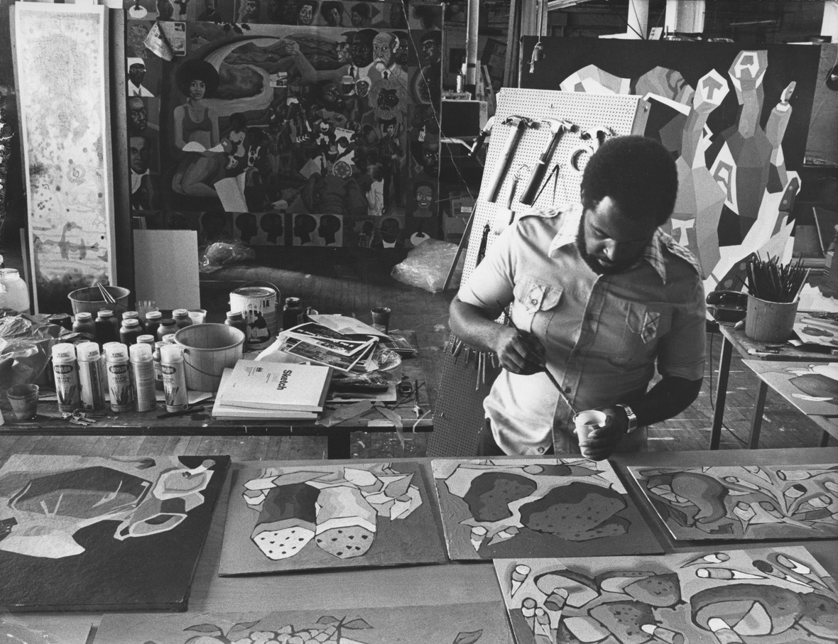
Encouraging Stewardship
Artist Dana Chandler painting in a studio. December 17, 1976. Northeastern University Library (Boston, Massachusetts), June 9, 2016. http://hdl.handle.net/2047/d20160915

Slide 7
Resources
DRS
DRS Resources
Contact
https://repository.library.northeastern.edu
http://library.northeastern.edu
sj.sweeney@neu.edu
Sarah Sweeney
Digital Repository Manager
Northeastern University Libraries
repository.library.northeastern.edu
Notes:
Promotional Slide

Slide 8
Citations
Archers from Boston-Bouve College. 1934. Northeastern University Library (Boston, Massachusetts). June 9, 2016, http://hdl.handle.net/2047/d20167889
A boy working on a project for his art class while five others look on at the South Boston Boys' Club. ca. 1945. Northeastern University Library (Boston, Massachusetts). June 9, 2016, http://hdl.handle.net/2047/d20164399
Chemistry professor and students. ca. 1925. Northeastern University Library (Boston, Massachusetts). June 9, 2016, http://hdl.handle.net/2047/d20161246
Cloonan, Michèle V, Martha R. Mahard. Collaborative Approaches to Teaching Digital Stewardship: Classroom, Laboratory, and Internships. Paper presented at IFLA-ALISE-EUCLID Conference, Cooperation and Collaboration in Teaching and Research: Trends in LIS Education, Borås, Sweden, August 8-9, 2010.
Digital Curation Centre. The DCC Curation Lifecycle Model. June 9, 2016, http://www.dcc.ac.uk/resources/curation-lifecycle-model
McCurry, Jaime. Digital Stewardship: The one with all the definitions. April 2, 2014. June 8, 2016, http://collation.folger.edu/2014/04/digital-stewardship-the-one-with-all-the-definitions
Schrader, Jerry. Artist Dana Chandler painting in a studio. December 17, 1976. Northeastern University Library (Boston, Massachusetts). June 9, 2016, http://hdl.handle.net/2047/d20160915

